Slide 1

Exploration Seismology and Disaster Management using DSP
EE338 : Application Assignment
Group 24

Slide 2





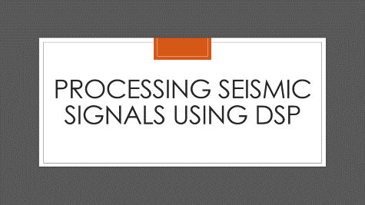

Slide 3
Introduction

Slide 4
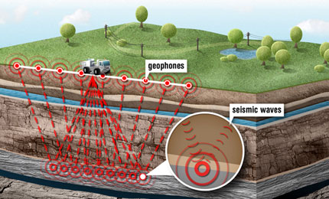
Introduction
Subsurface features, such as oil and gas reservoirs can be mapped by generating seismic waves and measuring their reflection amplitudes and phases. DSP plays a vital role in interpreting such data.
Picture Credits - EarthSky

Slide 5
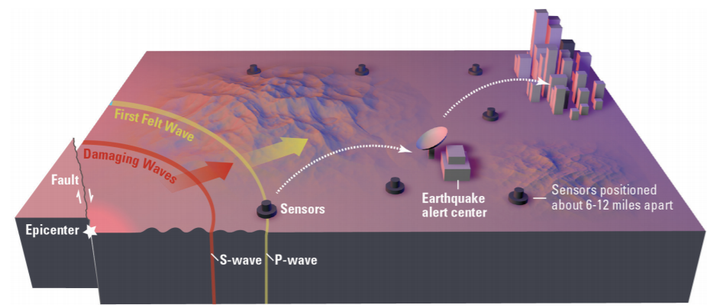
Introduction
Using similar DSP techniques, we propose to develop a Real time seismic alert system which will be helpful for disaster management and mitigation in case of minor seismic events like landslides and rockfalls.
Picture Credits - USGS

Slide 6
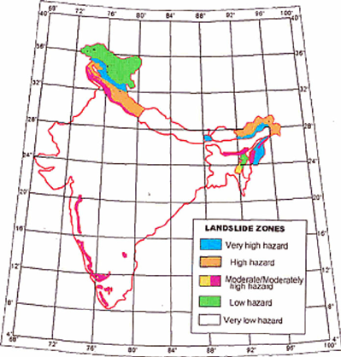
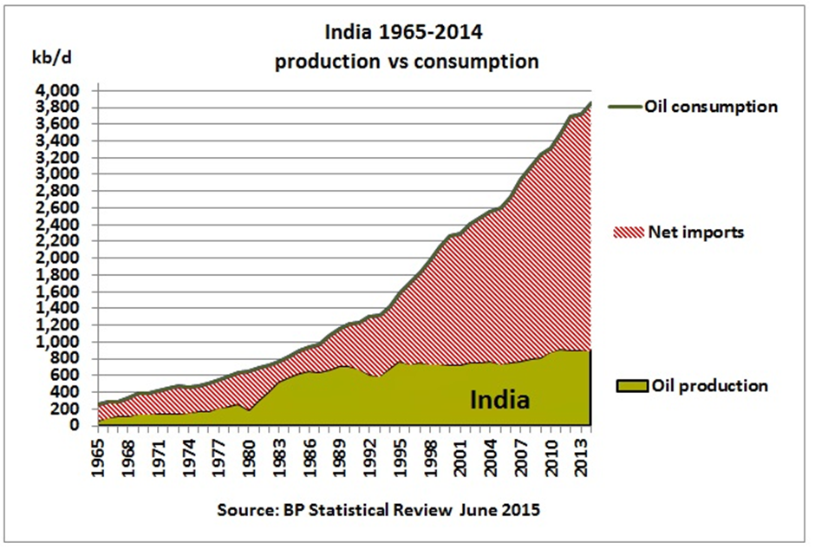
Relevance to Atmanirbhar Bharat
Picture Credits - GSI

Slide 7
Seismic Theory

Slide 8
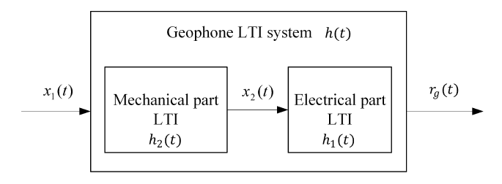
Geophone – LTI Systems
Picture Credits – ADSP on Seismic Data

Slide 9
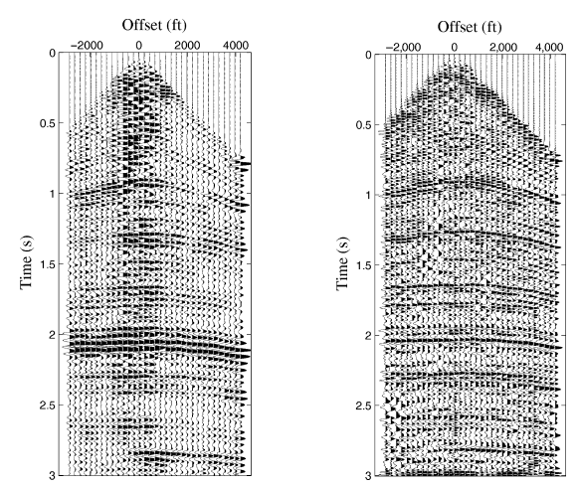
Seismic Data Processing
Deconvolution
Stacking
Migrating
Picture Credits – ADSP on Seismic Data

Slide 10
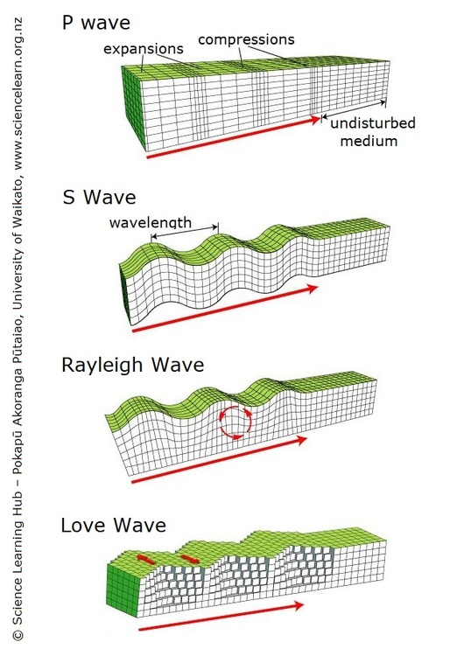
Seismic Waves
Picture Credits – Science Learning Hub

Slide 11
Processing Seismic Signals using DSP

Slide 12
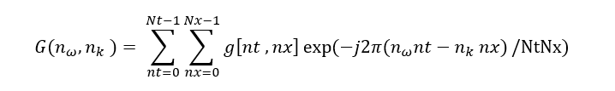
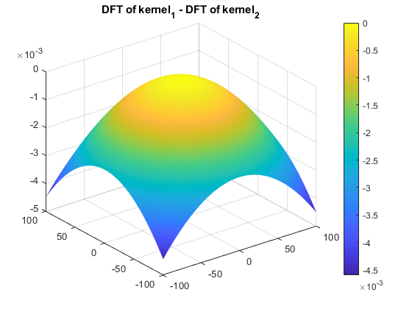
2D Discrete Time Fourier Transform

Slide 13
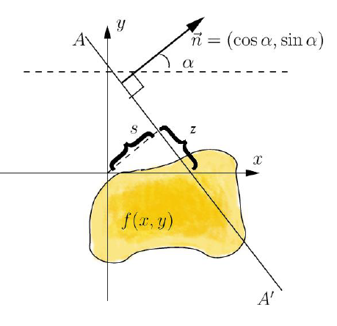
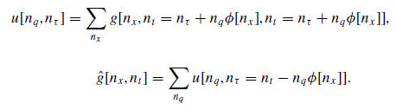
Radon Transform (Discrete)
Picture Credits – Wikipedia

Slide 14
Machine learning on seismic data (to augment DSP)
Machine Learning helps us learn from previous data; DSP based techniques will help us analyze the new signal from scratch. A combination of these techniques puts us in the best spot to make a decision or prediction.
Simulation performed on Python
Logistic Regression
94% accuracy

Slide 15
Disaster Management

Slide 16

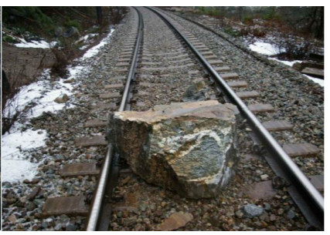
Minor Seismic Events
Picture Credits – Pierre-Arnaud Chouvy and CN Railway

Slide 17
Proposed Realtime Seismic Alarm System
Detection System
Alert Transmission System
Reaction System

Slide 18
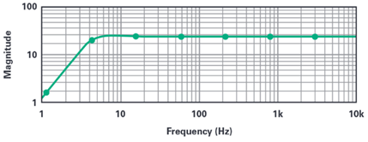
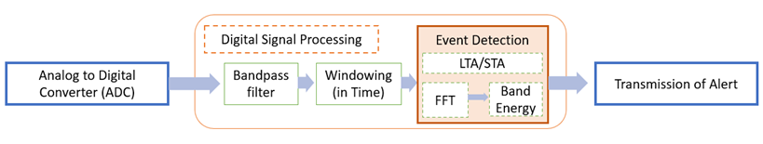
Detection System
Frequency (magnitude) Response of a typical Geophone
Embedded Processor System

Slide 19
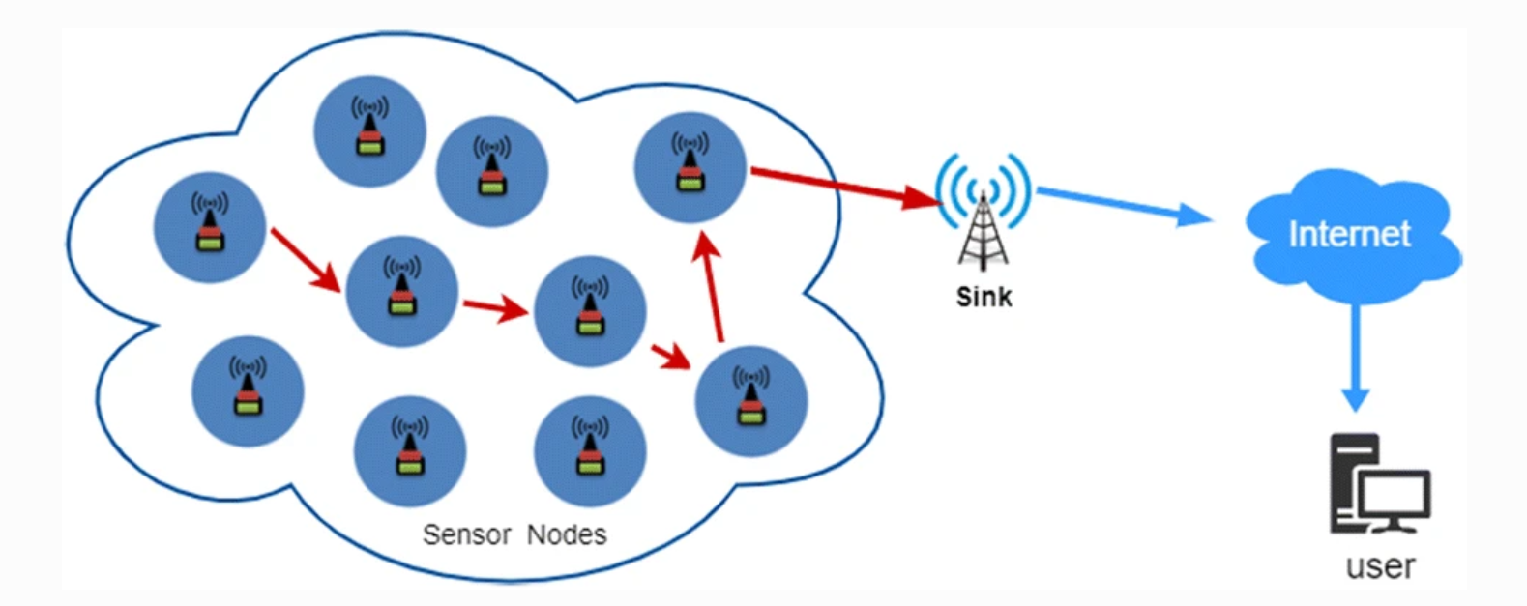
Transmission through Wireless Sensor Networks
Picture Credits – Zaher et al.

Slide 20
Event Detection Algorithms

Slide 21
Various Detection Algorithms
Amplitude Threshold Triggering (ATT)
STA/LTA Detector
Z Detector
Power Spectral Density (using STFT)

Slide 22
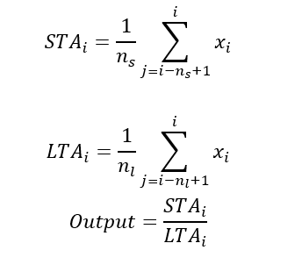
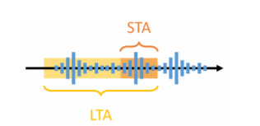
STA/LTA Detector
Picture Credits – I-Lin Fang, ETH Zurich

Slide 23
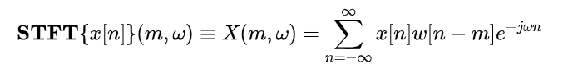
Power Spectral Density Method
Windowing
STFT implementation using FFT
Calculation of Power in the band

Slide 24
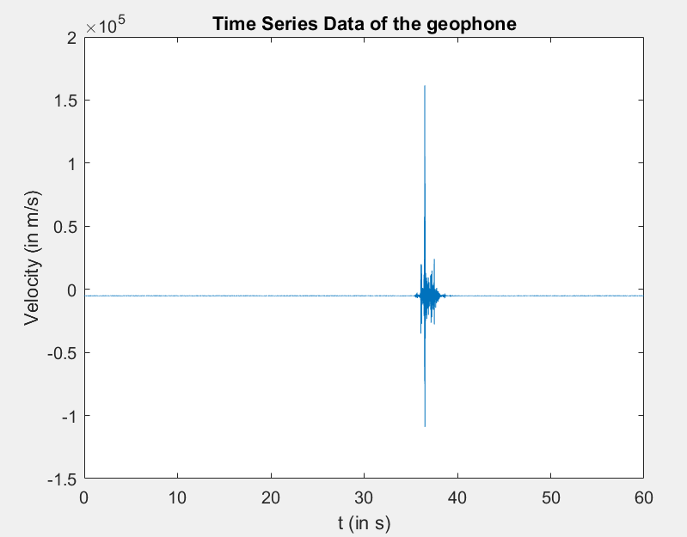
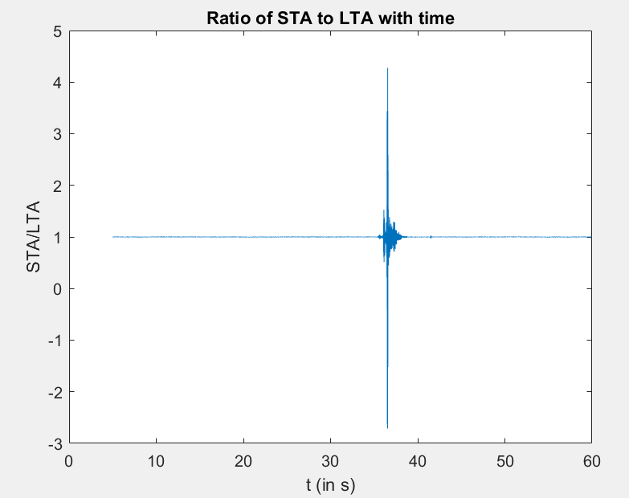
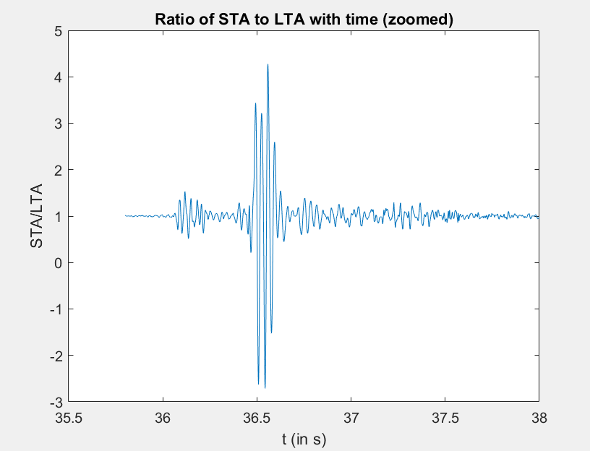
Simulation Results – STA/LTA

Slide 25
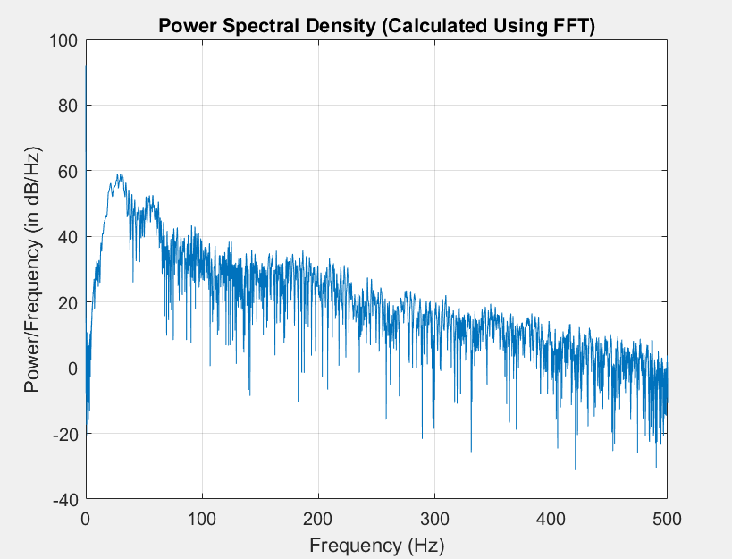
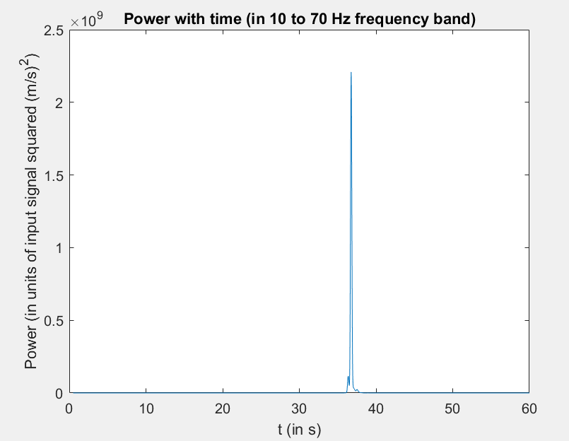
Simulation Results – PSD and FFT

Slide 26
Implementation Details

Slide 27
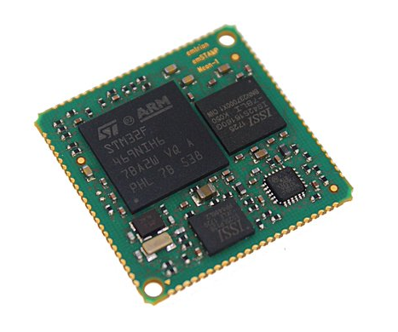
DSP Processor
ARM Cortex-M4 core-based STM32F469NIH6 micro controller unit
Includes a floating point unit
Full set of DSP instructions (CMSIS DSP Library)
Cost – roughly ₹1,000 per unit
Picture Credits – Emtrion

Slide 28
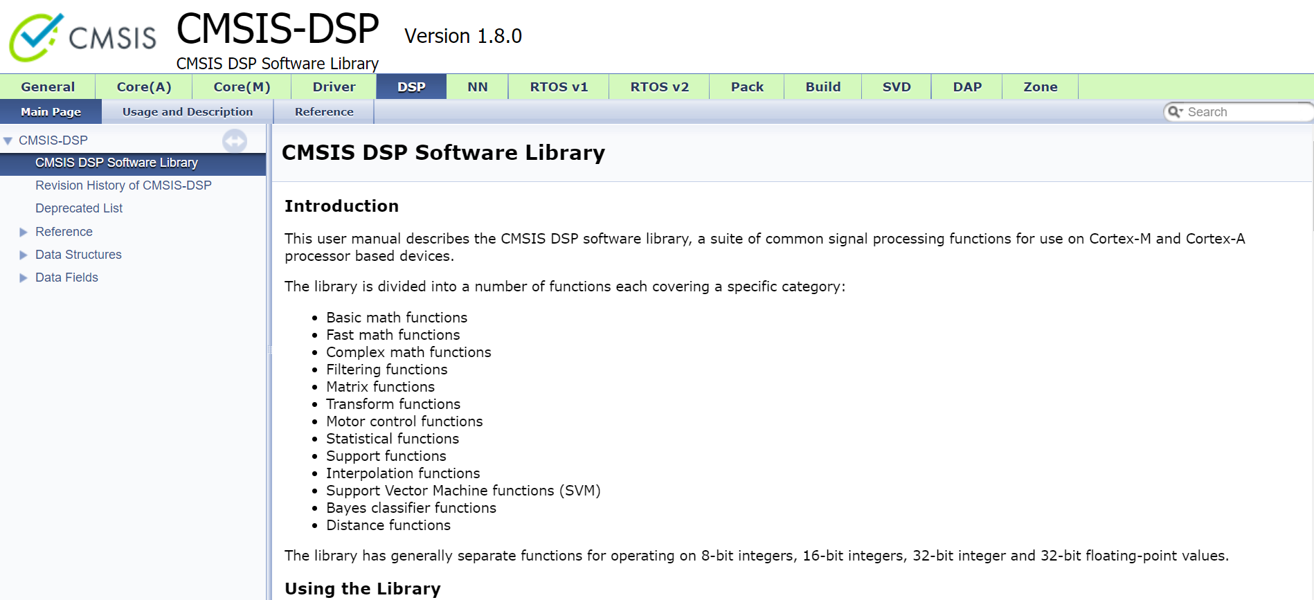
CMSIS DSP Library
Picture Credits – Arm Ltd.

Slide 29
Other components required
A suitable geophone could be used with usable frequency atleast from 10 Hz to 400 Hz, such as an SM-6 4.5 Hz geophone.
A analog to digital data converter (ADC) is also required which could be implemented through ADS1255 by Texas Instruments, which is a very low noise 24 bit Delta-Sigma precision ADC. This costs approximately ₹1,000 per unit as well.
Additional devices include the wireless communication module with antenna for the wireless sensor network, and the solar panels to power up the sensor node, with stored battery backup if required. The backend components including the central node and the warning and reaction system have to be implemented separately as well.

Slide 30
References and Sources
Numerical Methods of Exploration Seismology with Algorithms in MATLAB, Gary F. Margrave, Michael P. Lamoureux, Cambridge University Press, December 2018
Advanced Digital Signal Processing of Seismic Data, Mousa, Wail A., Cambridge University Press, 2019.
Seismic Detection Of Rockfalls On Railway Lines by Bohdan Nedilko, (Doctoral Thesis), The University Of British Columbia (2016)
Fang, I-Lin. (2018). Digital Signal Processing for Minor-Seismic Event Detection on Embedded Platforms (Master’s Thesis).
Additional references and sources are given in the application assignment report

